Slide 1






Marketplace MVP Development
Thomas Derave
Notes:
Department of Business Informatics and Operations Management

Slide 2
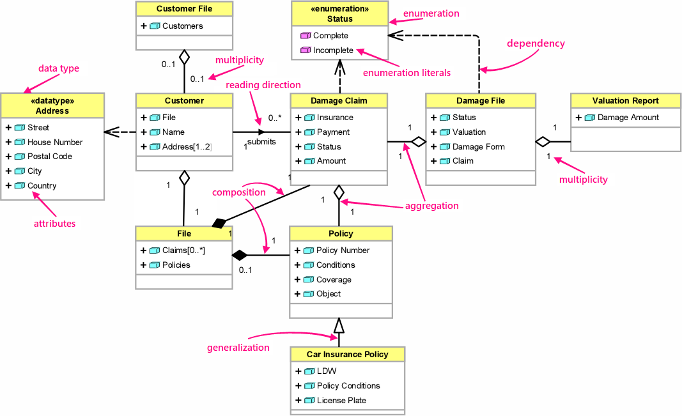
UML

Slide 3
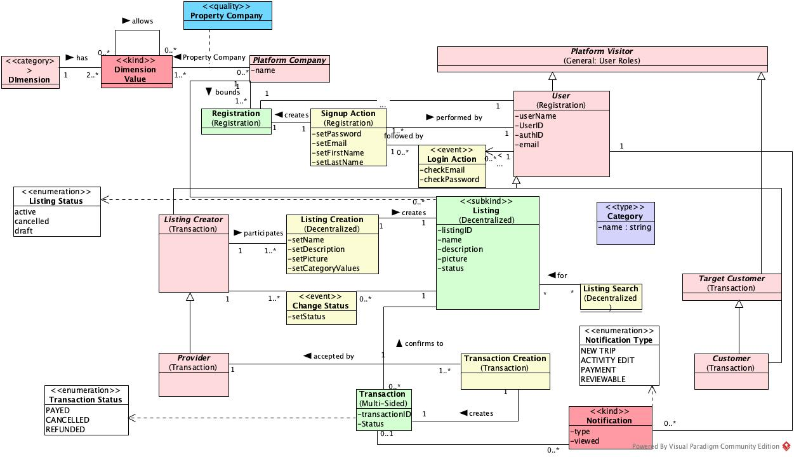
OntoUML: Ontological architecture model

Slide 4


Slide 5
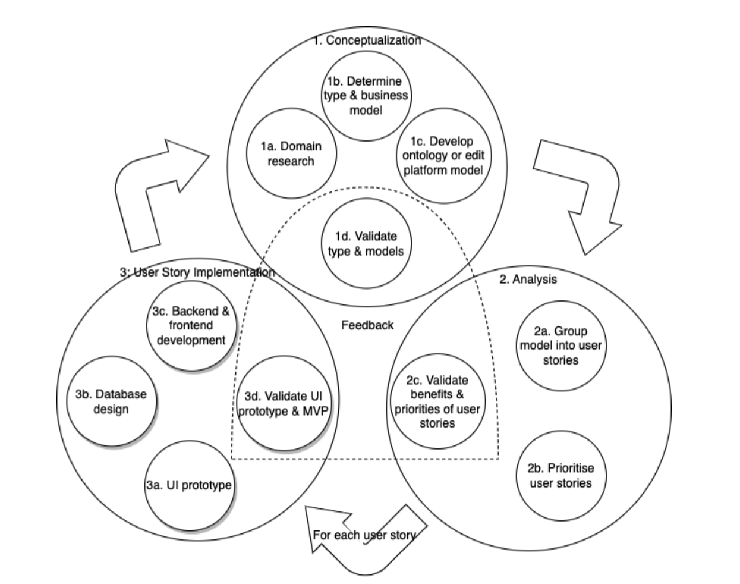
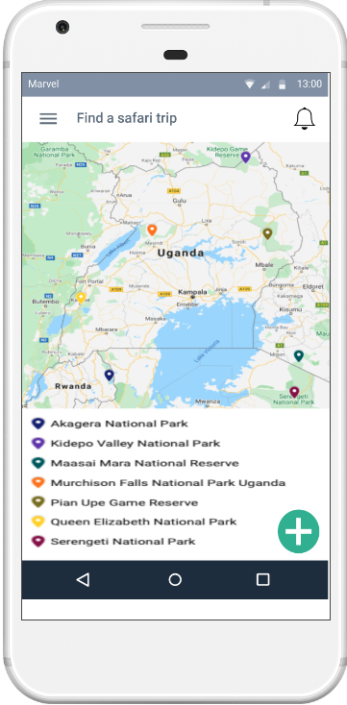
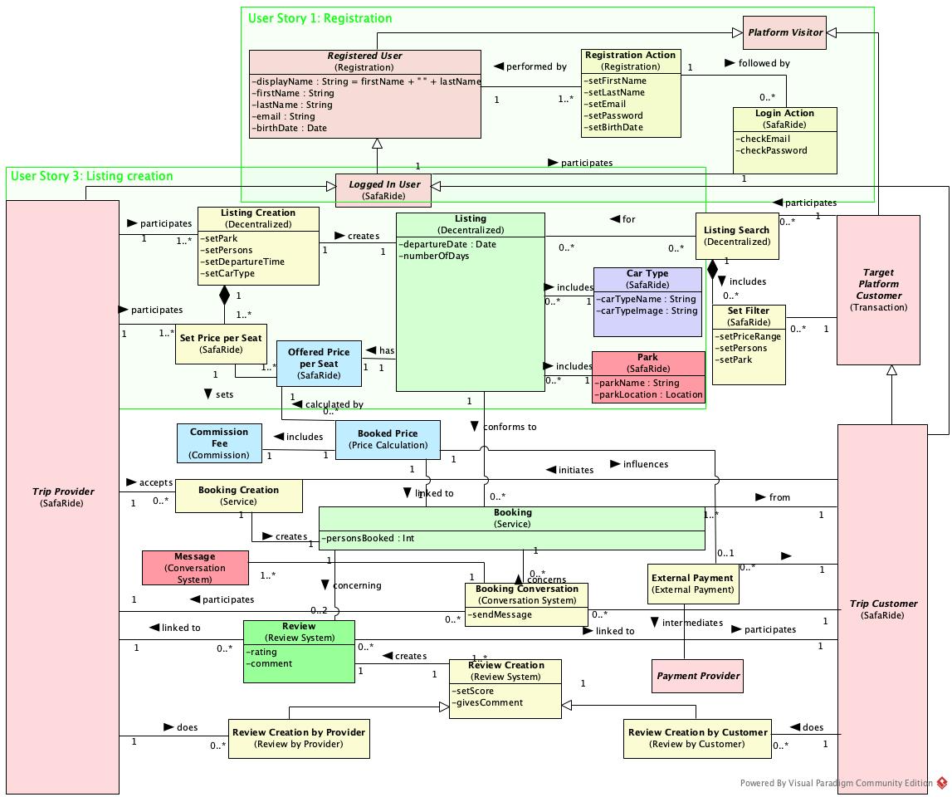
A METHOD FOR MODEL-DRIVEN MVP DEVELOPMENT

Slide 6
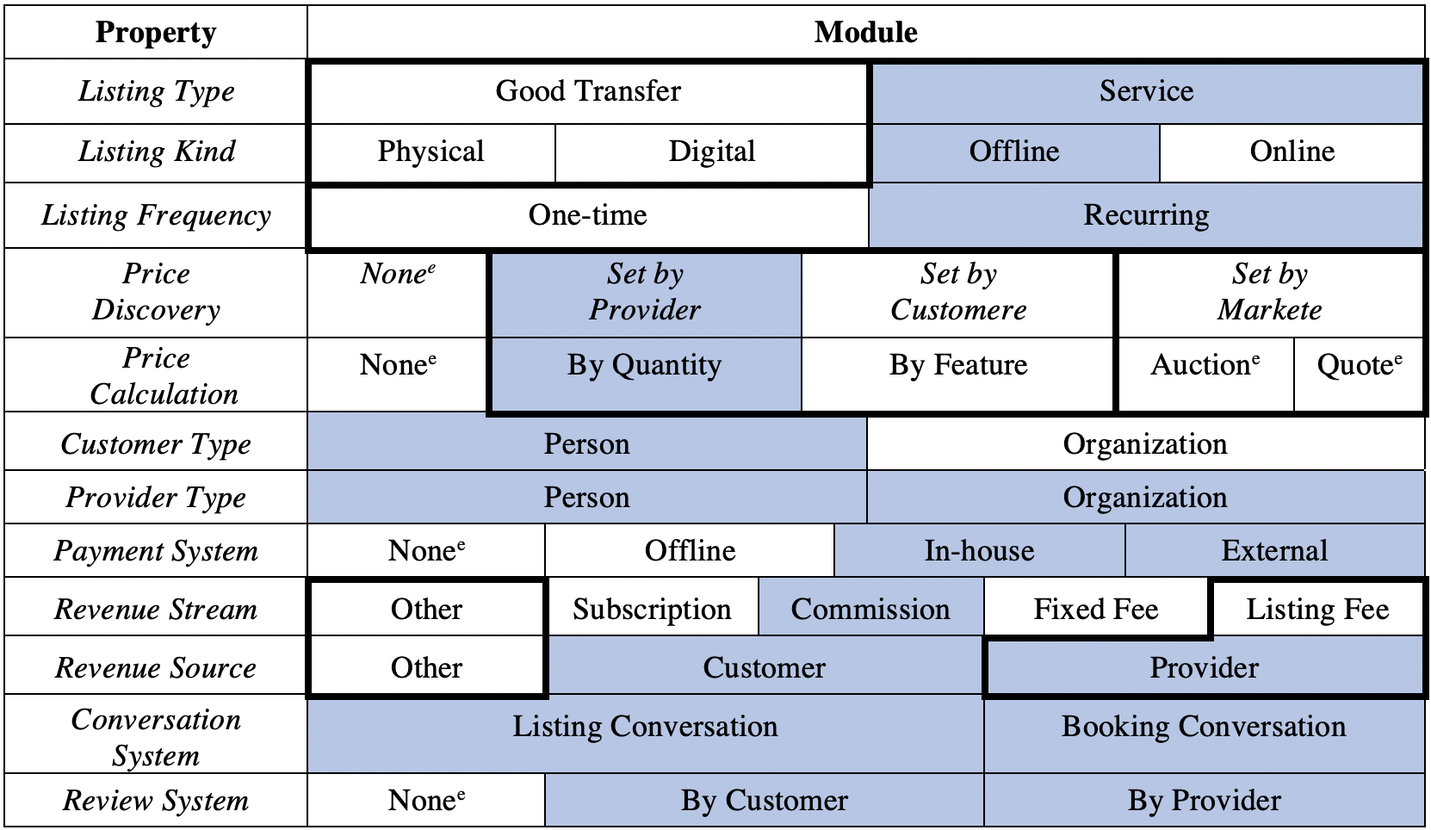
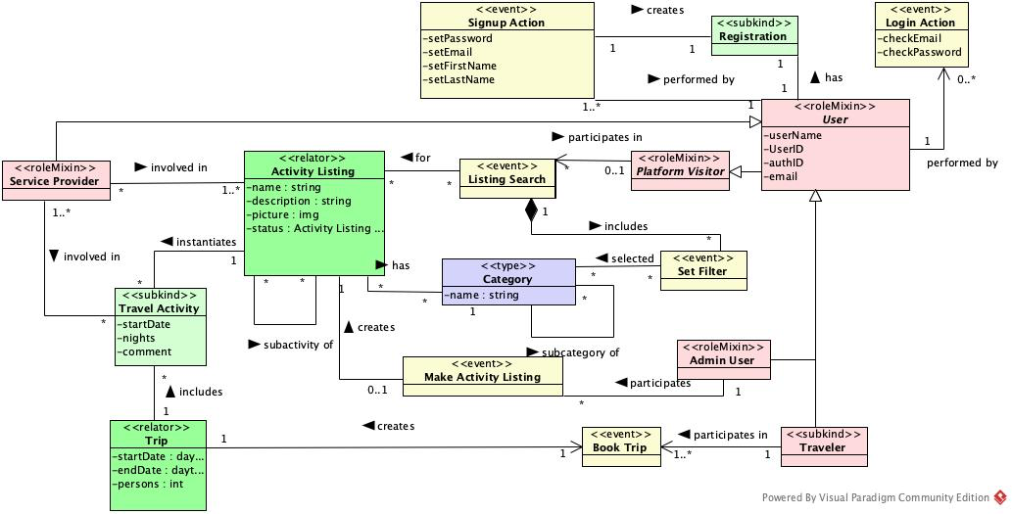
1. CONCEPTUALIZATION
Platform-specific model

Slide 7
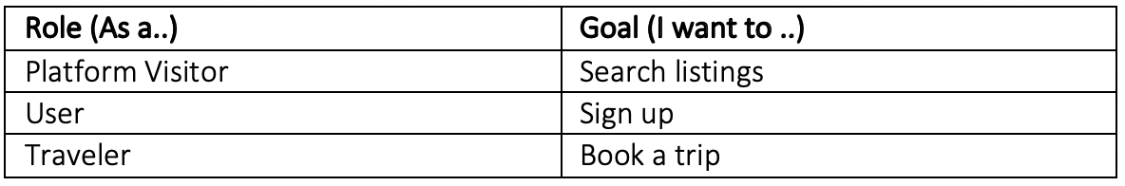
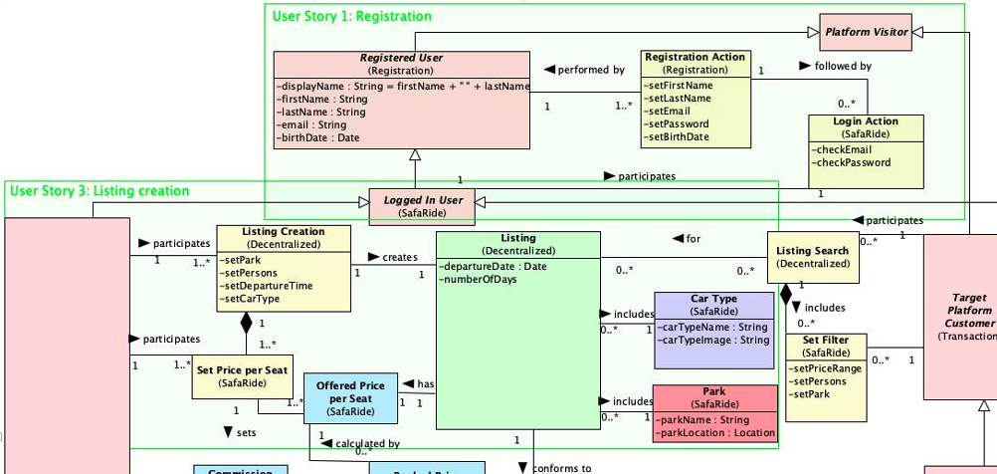
2. ANALYSIS

Slide 8
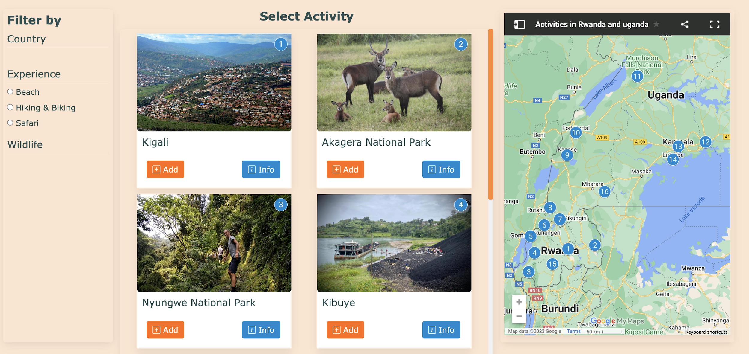
3. USER STORY IMPLEMENTATION

Slide 9

FEEDBACK

Slide 10
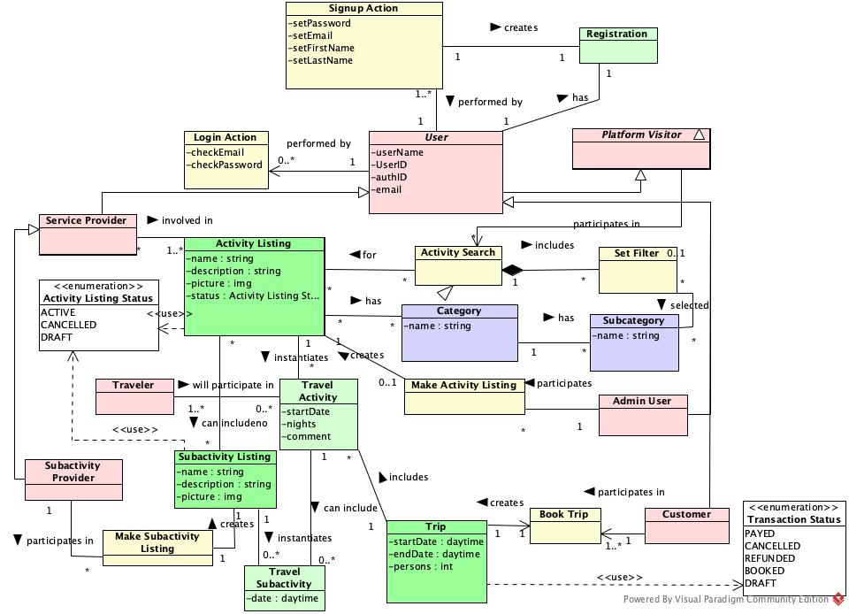
1. CONCEPTUALIZATION 2.0
Platform Software Model
Notes:
where the platform-specific ontology is used in the initial iteration and the platform software model is employed in later iterations as a documentation, structuring, and validation tool

Slide 11
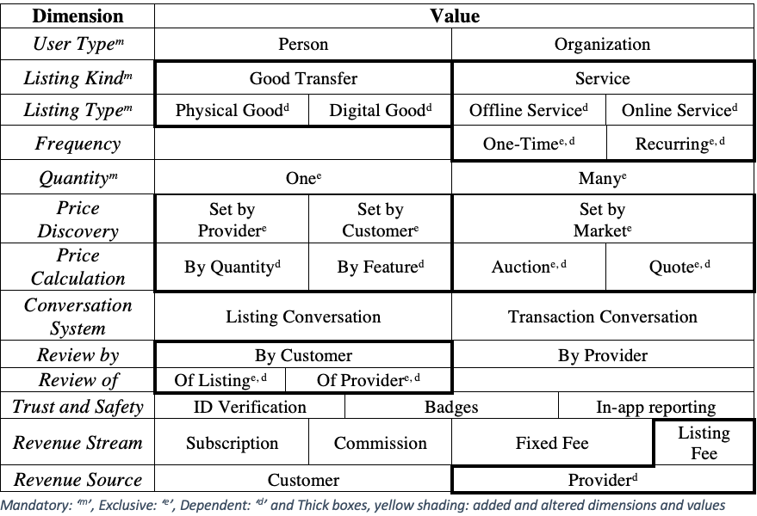
Fill in taxonomy

Slide 12

Thomas Derave
PhD Student and assistent
Faculty of Economics and Business Administration
Department of Business Informatics and Operations Management
thomas.derave@ugent.be
www.model-a-platform.com

